Slide 1
Pitch Shifting
Bc. Erika Do
Bc. Jakub Július Šmýkal
CZSa Project 2024/2025

Slide 2
Motivation
Implement a basic pitch-shifting algorithm that maintains audio quality and is computationally efficient.
Compare the audio quality with different pitch shifting techniques.
Compared techniques:
Change of sampling frequency
Synchronized Overlap-Add (SOLA)
Phase Vocoder
Librosa Vocoder

Slide 3
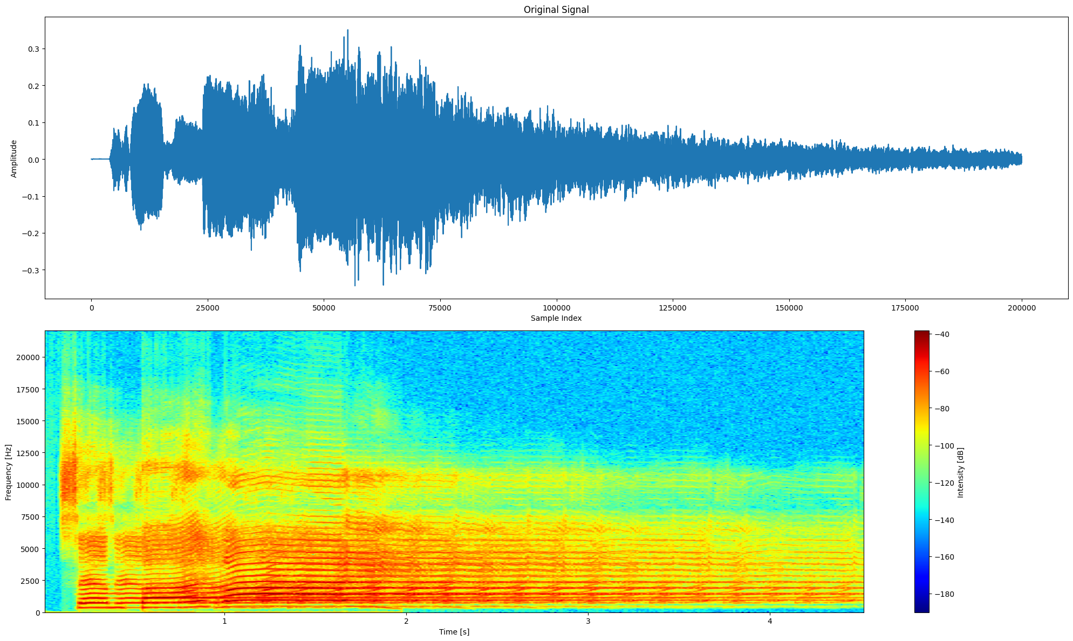

Original Audio

Slide 4
SOLA
Technique based on splitting the signal into short frames, which are shifted by selected number of semitones and then added back together.
To ensure smaller number of artifacts, this algorithm tries to match the waveforms across overlapping frames.
The similarity of waveforms is determined by autocorrelation, which computes the inner product between a signal and its shifted (lagged) version over a specified time lag. The time lag that produces the highest correlation indicates the best placement of the window. This method also considers the signs of the signal.

Slide 5
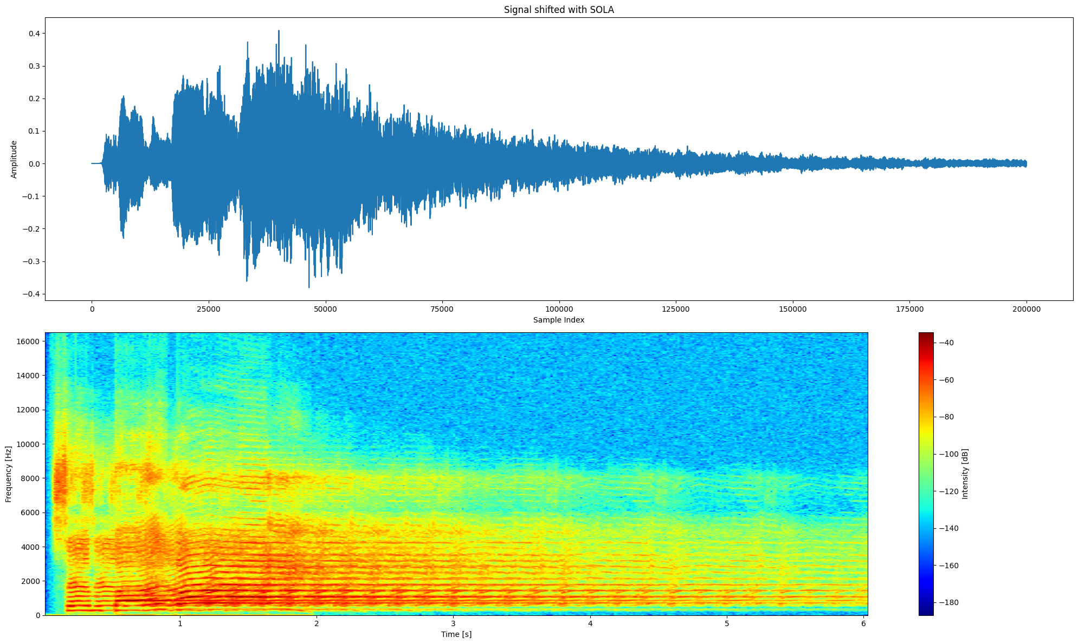
SOLA

Slide 6
Phase Vocoder
This algorithm works by modifying the signal in the frequency domain and then reconstructing the signal.
Signal altered in three phases:
Analysis
The input signal is divided into small frames, and its spectral components are extracted using a Fourier transform (STFT).
Processing
The spectral components are modified, such as altering the pitch, time, or adding effects like modulation or filtering.
Synthesis
The modified spectral components are then transformed back into the time domain using an inverse Fourier transform, reconstructing the processed signal.

Slide 7
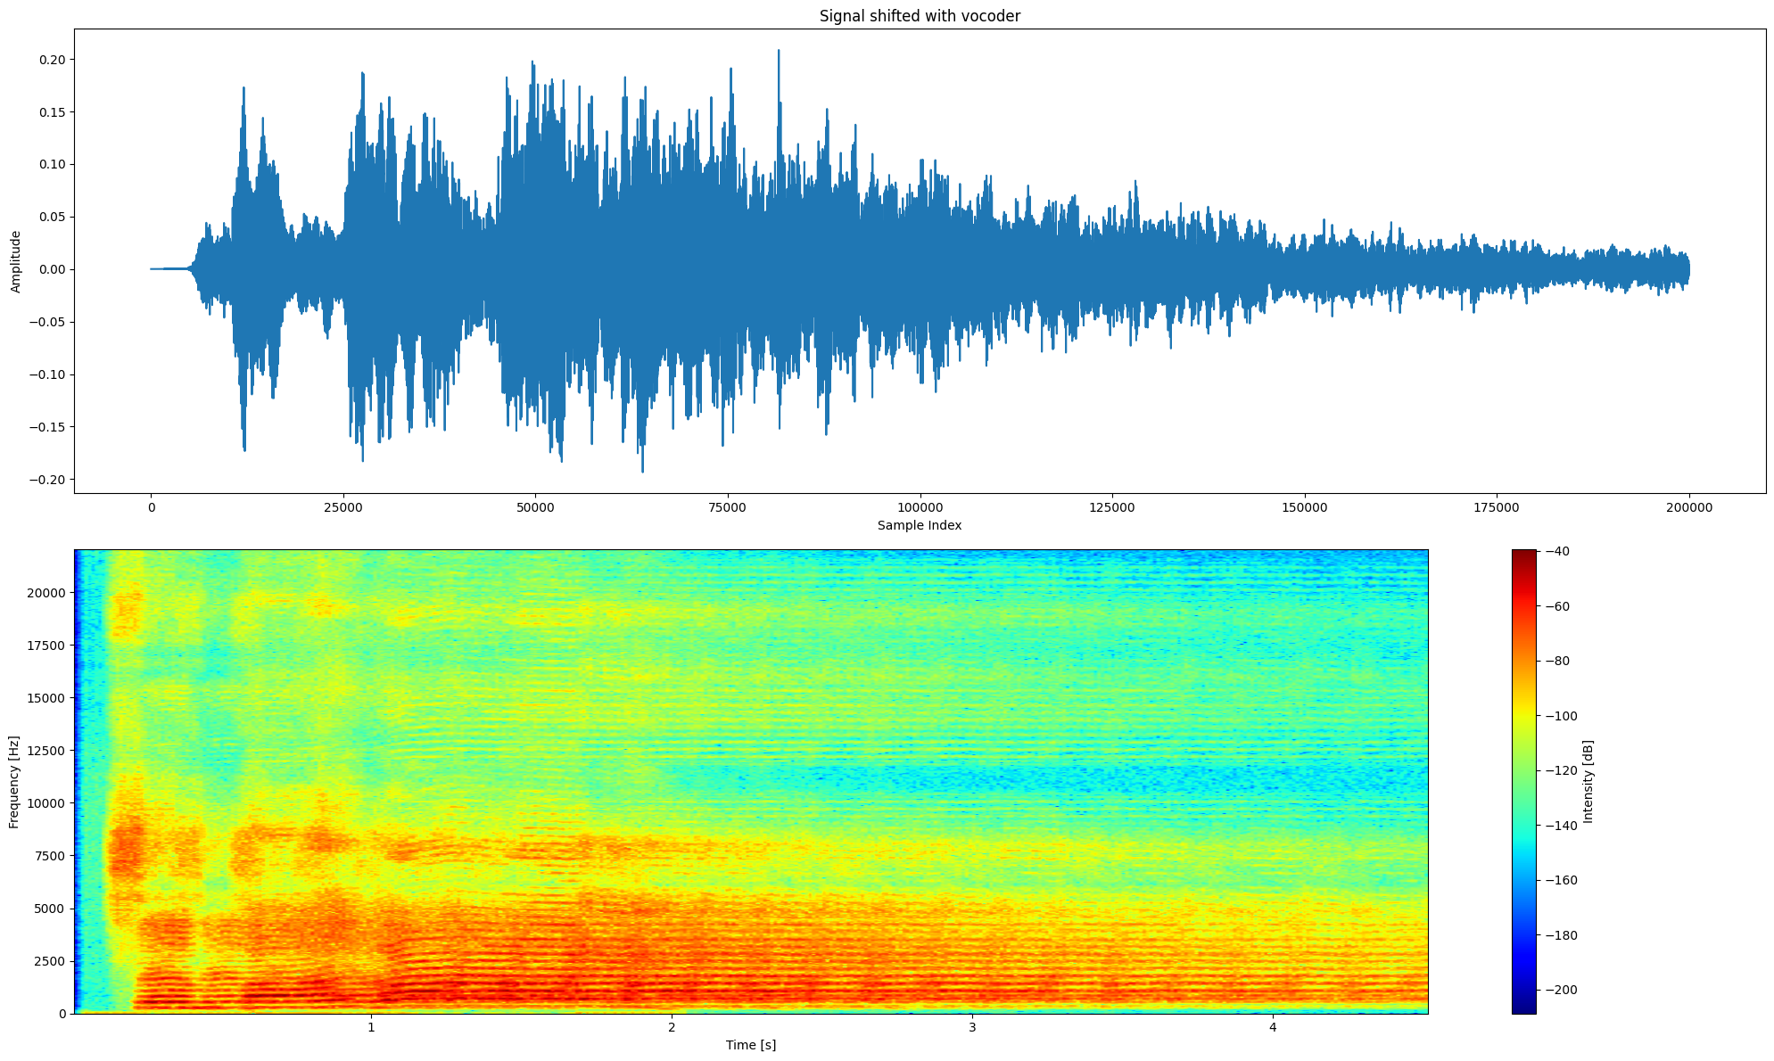
Phase Vocoder

Slide 8
Librosa
Librosa is a Python library for analyzing and processing audio, particularly for music and speech tasks.
It implements a method librosa.effects.pitch_shift.
This function shifts the pitch of an audio signal by a specified number of semitones without affecting its duration.
It also uses phase vocoder technique.

Slide 9
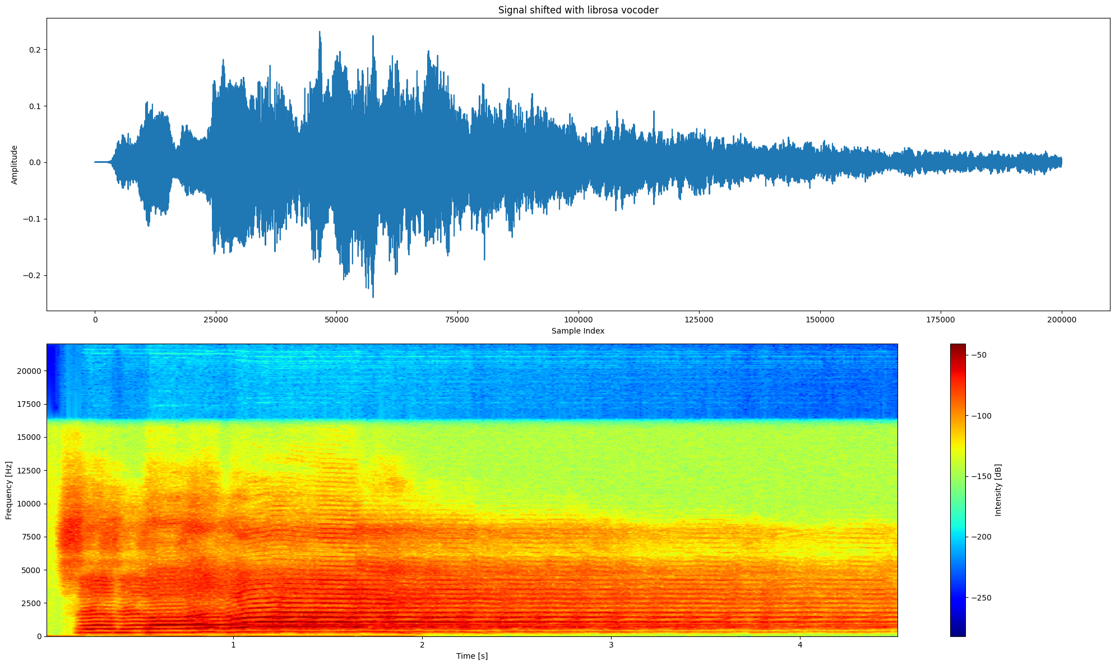
Librosa

Slide 10

Thank you for your attention
WHAT THE FFT

